Slide 1
Spinner and RecyclerView

Slide 2

Using Spinners

Slide 3
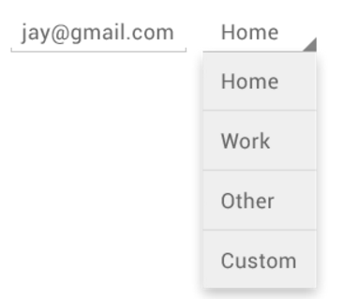
What is Spinner?
Spinners provide a quick way to select one value from a set.
In the default state, a spinner shows its currently selected value.
Touching the spinner displays a dropdown menu with all other available values, from which the user can select a new one.
You can add a spinner to your layout using the <Spinner> element.

Slide 4
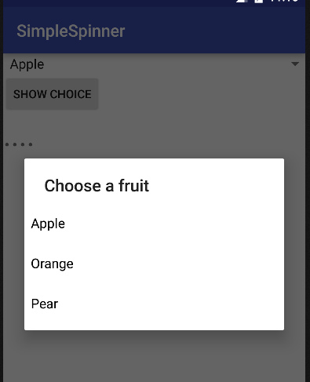
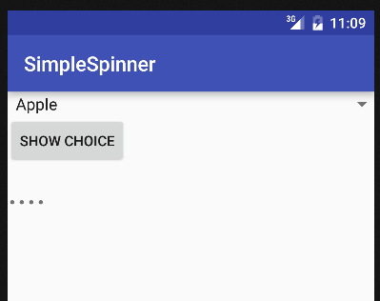
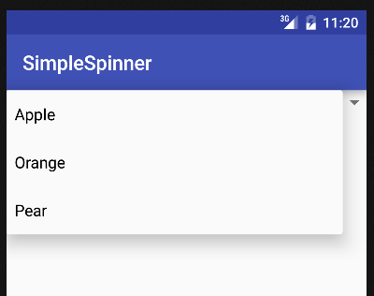
Example
android:spinnerMode="dialog"
android:spinnerMode=“dropdown"

Slide 5
Example – The Layout
<LinearLayout . . . . . .>
<Spinner
android:id="@+id/spinner1"
android:layout_width="match_parent"
android:layout_height="wrap_content"
android:prompt="@string/prompt"
android:entries="@array/choices"
android:spinnerMode="dialog" />
<Button
android:id="@+id/button1"
. . . . . . />
<TextView
android:id="@+id/textView1"
. . . . . ./>
</LinearLayout>

Slide 6
Example – strings.xml
<resources>
<string name="app_name">SimpleSpinner</string>
<string name="prompt">Choose a fruit</string>
<string-array name="choices">
<item>Apple</item>
<item>Orange</item>
<item>Pear</item>
</string-array>
</resources>
<LinearLayout . . . . . .>
<Spinner
android:id="@+id/spinner1"
android:layout_width="match_parent"
android:layout_height="wrap_content"
android:prompt="@string/prompt"
android:entries="@array/choices"
android:spinnerMode="dialog" />
<Button
android:id="@+id/button1"
. . . . . . />
<TextView
android:id="@+id/textView1"
. . . . . ./>
</LinearLayout>

Slide 7
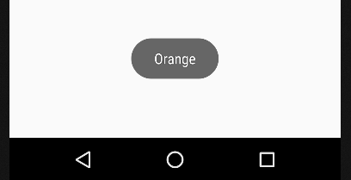
Example – MainActivity.java (Part 1)
public class MainActivity extends Activity {
private Spinner spinner1;
. . . . . .
@Override
protected void onCreate(Bundle savedInstanceState) {
super.onCreate(savedInstanceState);
setContentView(R.layout.activity_main);
spinner1 = findViewById(R.id.spinner1);
. . . . . .
spinner1.setOnItemSelectedListener(new OnItemSelectedListener(){
@Override
public void onItemSelected(AdapterView<?> parent, View view,
int position, long id) {
// The item at "position" is selected!
String choice = parent.getItemAtPosition(position).toString();
Toast.makeText(MainActivity.this, choice, Toast.LENGTH_LONG).show();
}
@Override
public void onNothingSelected(AdapterView<?> parent) {
// Ignore this!
}
});
. . . . . .
}
}

Slide 8
Example – MainActivity.java (Part 2)
public class MainActivity extends Activity {
private Spinner spinner1;
. . . . . .
@Override
protected void onCreate(Bundle savedInstanceState) {
super.onCreate(savedInstanceState);
setContentView(R.layout.activity_main);
spinner1 = (Spinner) findViewById(R.id.spinner1);
button1 = (Button) findViewById(R.id.button1);
textView1 = (TextView) findViewById(R.id.textView1);
spinner1.setOnItemSelectedListener( . . . . . . );
button1.setOnClickListener(new OnClickListener(){
@Override
public void onClick(View view) {
String s = spinner1.getSelectedItem().toString();
textView1.setText(s);
}
});
}
}

Slide 9
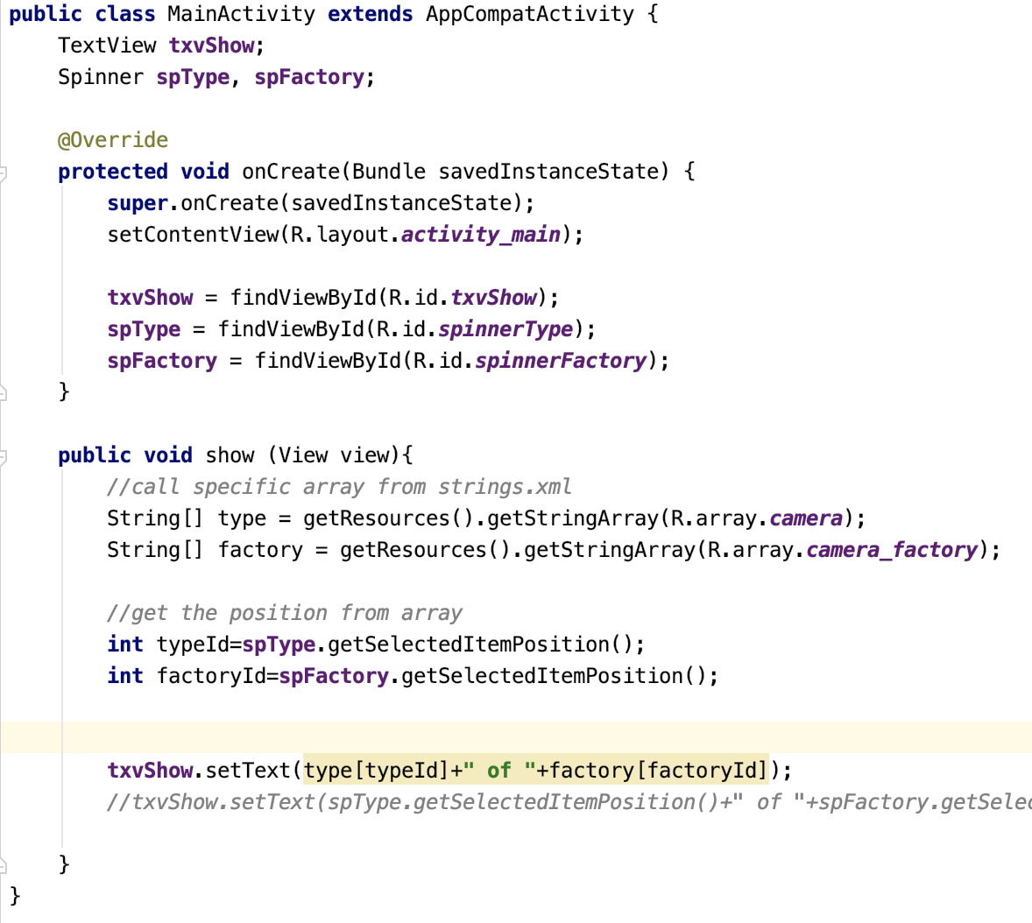
Example 2
Get the array from strings.xml

Slide 10
Using RecyclerView

Slide 11
Introduction to RecyclerView
It is the is a view group that displays a list of scrollable items.
Eg. The list of the message app
It needs to cooperate with Adapter

Slide 12
What is Adapter?
A bridge between data source and adapter view
Eg. ArrayAdapter, SimpleCursorAdapter etc.
Data source
Adapter
Adapter View
Cursor
Arraylist
RecyclerView
Spinner

Slide 13
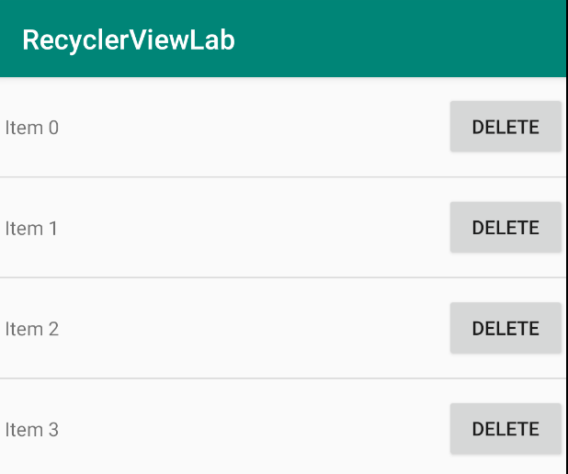
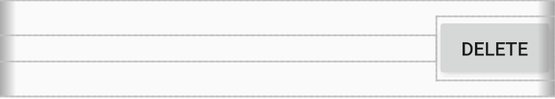
ViewHolder
To enhance the performance and to prevent too much identification of similar object
Use ViewHolder and just design one of the column (Fig 2), it will be generated the same pattern likes Fig 1.
Fig 2
Fig 1

Slide 14
Example code (MyAdapter.java)
public class MyAdapter extends RecyclerView.Adapter<MyAdapter.ViewHolder> { private List<String> mData; MyAdapter(List<String> data) { mData = data; //put the list data(mData) into data }
// ViewHolder code, see next two page
}

Slide 15
class ViewHolder extends RecyclerView.ViewHolder{ private TextView txtItem; private Button btnRemove; ViewHolder(View itemView) { super(itemView); txtItem = itemView.findViewById(R.id.txtItem); btnRemove = itemView.findViewById(R.id.btnRemove);
// you can define some action here, eg action after clicking button
}
txtItem
btnRemove

Slide 16
@Override public ViewHolder onCreateViewHolder(ViewGroup parent, int viewType) {
// used to link list_items.xml
View view = LayoutInflater.from(parent.getContext()) .inflate(R.layout.list_items, parent, false);
return new ViewHolder(view);
} @Override public void onBindViewHolder(ViewHolder holder, int position) {
// set the display information of txtItem (Item 0 etc)
holder.txtItem.setText(mData.get(position));
}
Remark : LayoutInflater is also used to load the layout, similar with setContentView()

Slide 17
Example code (MainActivity.java)
public class MainActivity extends AppCompatActivity { private RecyclerView recycler_view; private MyAdapter adapter; private ArrayList<String> mData = new ArrayList<>(); @Override protected void onCreate(Bundle savedInstanceState) { ...
recycler_view = findViewById(R.id.recycler_view);
adapter = new MyAdapter(mData);
// set adapter for recycler_view recycler_view.setAdapter(adapter); }

Slide 18
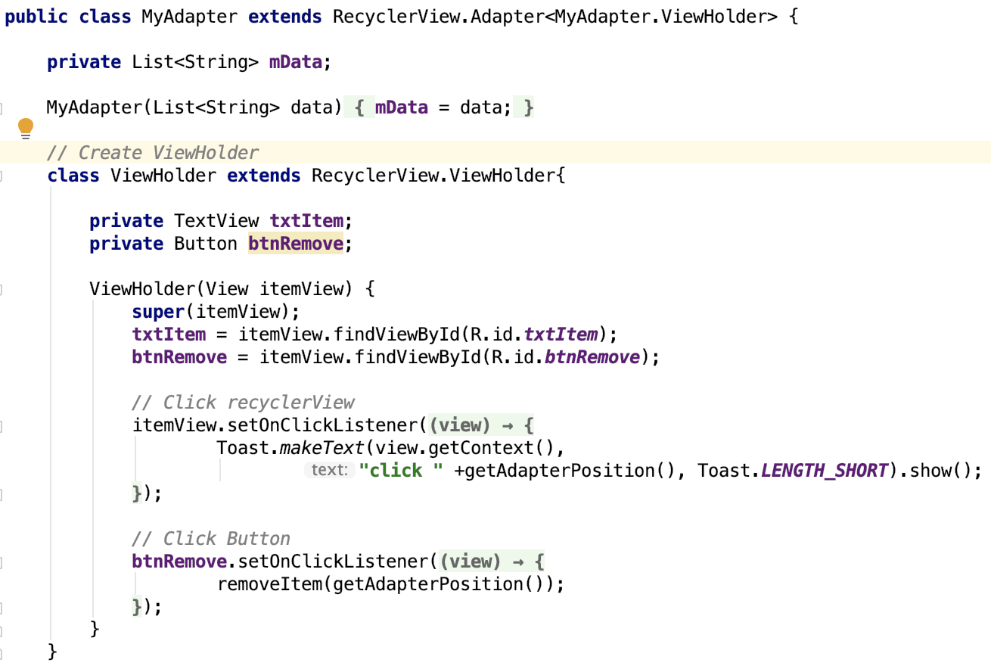
MyAdapter.java

Slide 19
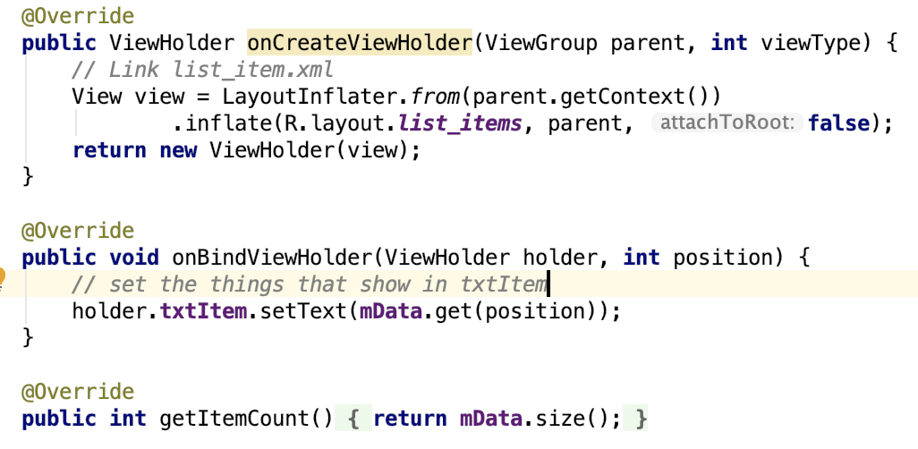

Slide 20
Menus

Slide 21
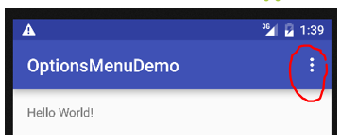
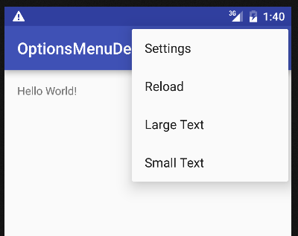
Introduction - Menu
Menus are a common user interface component in many types of applications.
Options Menu and Context Menu are the most commonly used menus in Android.
An example on the right:
Option Menu

Slide 22
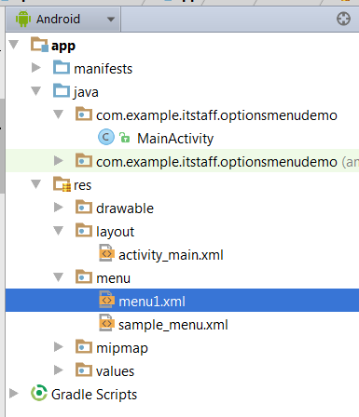
OptionMenu Items – menu1.xml
<menu xmlns:android="http://schemas.android.com/apk/res/android">
<item
android:id="@+id/action_settings"
android:title="Settings">
</item>
<item
android:id="@+id/action_reload"
android:title="Reload">
</item>
<item
android:id="@+id/action_large"
android:title="Large Text">
</item>
<item
android:id="@+id/action_small"
android:title="Small Text">
</item>
</menu>

Slide 23
OptionMenu E.g.– MainActivity.java (1)
public class MainActivity extends AppCompatActivity {
@Override
protected void onCreate(Bundle savedInstanceState) {
super.onCreate(savedInstanceState);
setContentView(R.layout.activity_main);
}
@Override
public boolean onCreateOptionsMenu(Menu menu) {
MenuInflater inflater = getMenuInflater();
inflater.inflate(R.menu.menu1, menu);
return true;
}
. . . . . .
Prepare the Option Menu
See menu1.xml

Slide 24

OptionMenu E.g.– MainActivity.java (2)
. . . . . .
@Override
public boolean onOptionsItemSelected(MenuItem item) {
switch ( item.getItemId() ) {
// action with ID action_settings was selected
case R.id.action_settings:
Toast.makeText( this, "Settings selected", Toast.LENGTH_SHORT ).show();
break;
case R.id.action_reload:
Toast.makeText( this, "Reload selected", Toast.LENGTH_SHORT ).show();
break;
. . . . . .
default:
break;
}
return true;
}
}
Response to the menu item selection.

Slide 25
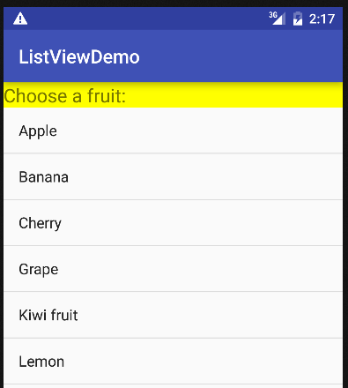
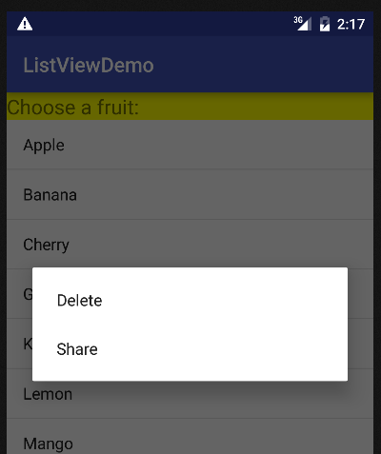
Context Menu
Context Menu offers actions that affect a specific item or context frame in the UI.
Context Menu can be used for any views, but it is more often for ListView items.
E.g. Long-pressing an item (e.g. Banana) will display the following context menu (Delete / Share):

Slide 26
MainActivity-> onCreate()
selection = findViewById(R.id.selection);
registerForContextMenu(selection);

Slide 27
@Override public void onCreateContextMenu(ContextMenu menu, View v, ContextMenu.ContextMenuInfo menuInfo) { super.onCreateContextMenu(menu, v, menuInfo); MenuInflater inflater = getMenuInflater(); inflater.inflate(R.menu.menu, menu); } @Override public boolean onContextItemSelected(@NonNull MenuItem item) { switch (item.getItemId()) { case R.id.action_wiki: Intent intent = new Intent(Intent.ACTION_VIEW, Uri.parse("https://en.wikipedia.org/wiki/Planet")); startActivity(intent); return true; case R.id.action_exit: finish(); return true; default: return super.onContextItemSelected(item); } }

